Slide 1
Virgin
Galactic
CMPN 280: Computer Organization
By: Tauney Mack , Shivang Patel
Fall Semester

Slide 2
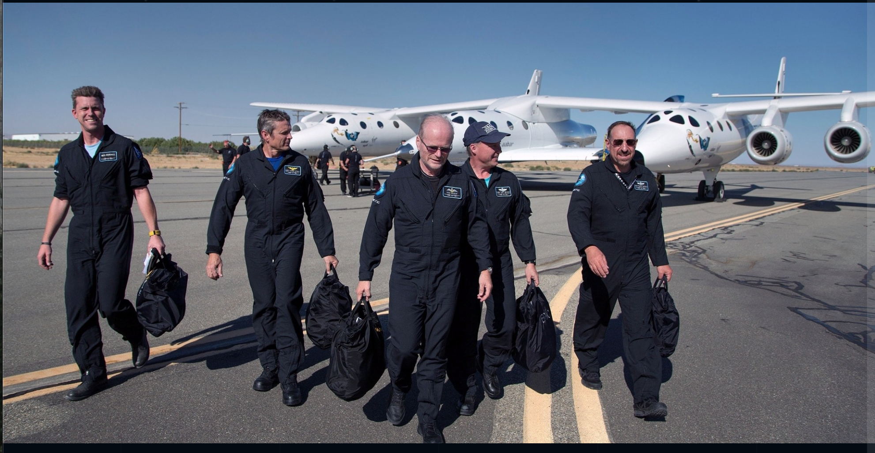
Executive Summary
Our presentation covers the mission and plans for the company Virgin Galactic. We designed and implemented a circuit that allows the space carrier to detach from the spaceship at the desired altitude.

Slide 3
Agenda
Purpose Project
Background
Problem statement
Proposed Project Design
Demonstration
Conclusion

Slide 4
Agenda
Purpose Project

Slide 5
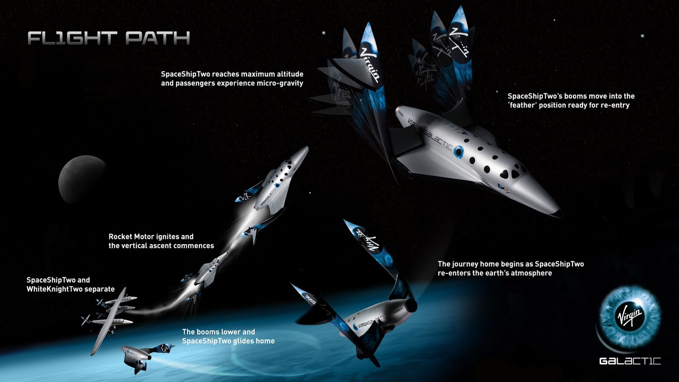
Purpose Project
The purpose of our project is to design a circuit to show the air-launching space vehicle (WhiteKnightTwo) disengaging from the spacecraft (SpaceShipTwo) after carrying it up into the sky at an altitude of about 50,000 feet. The completion of the two planes seperating is represented by the illumination of a single light.

Slide 6
Agenda
Background

Slide 7

Background
We are working as two computer science engineers who decided to join the new branch of the airline company Virgin Atlantic. This branch called Virgin Galactic focuses on space travel. Their mission is to develop and operate the new generation of space vehicles to open space for everyone to use. They want to give a diverse group of people a personal experience of space as soon as it is safely possible.
The company decides to design a carrier aircraft and a spaceship that work in tangent to deliver the astronauts into the earth’s atmosphere. The spaceship will then be tilted and controlled from earth to give the best views of space and our planet possible.

Slide 8
Agenda
Problem statement

Slide 9

Problem statement
Virgin Galactic needs the carrier airplane to let go of the spaceship once they both reach 50,000 feet to release it into the earth’s atmosphere. The carrier needs to count the increase in the altitude in the air. So we came up to efficiently show the design for the spaceship detaching from the plane.

Slide 10
Agenda
Proposed Project Design

Slide 11
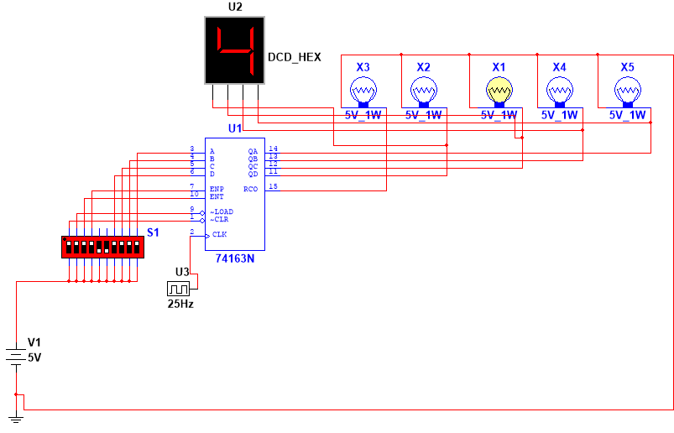
Proposed Project Design
For our project design, we modeled our circuit using the lab one, binary counter, as a template.
In our project, we used a binary counter and lightbulbs to display the number in binary. We used a NAND gate to reset and our counter when it reaches five. We used 3 NOT gates that connect to the lights that are not lit when the counter reaches 5 (00101). We used an AND gate that connected to the lightbulbs that are lit.
An additional AND gate connects the 2 AND gates to be true and make the light turn on, to signify the disengagement of the spaceship from the carrier in the atmosphere.

Slide 12
Agenda
Demonstration

Slide 13
Demonstration
( run the project )

Slide 14
Agenda
Conclusion

Slide 15
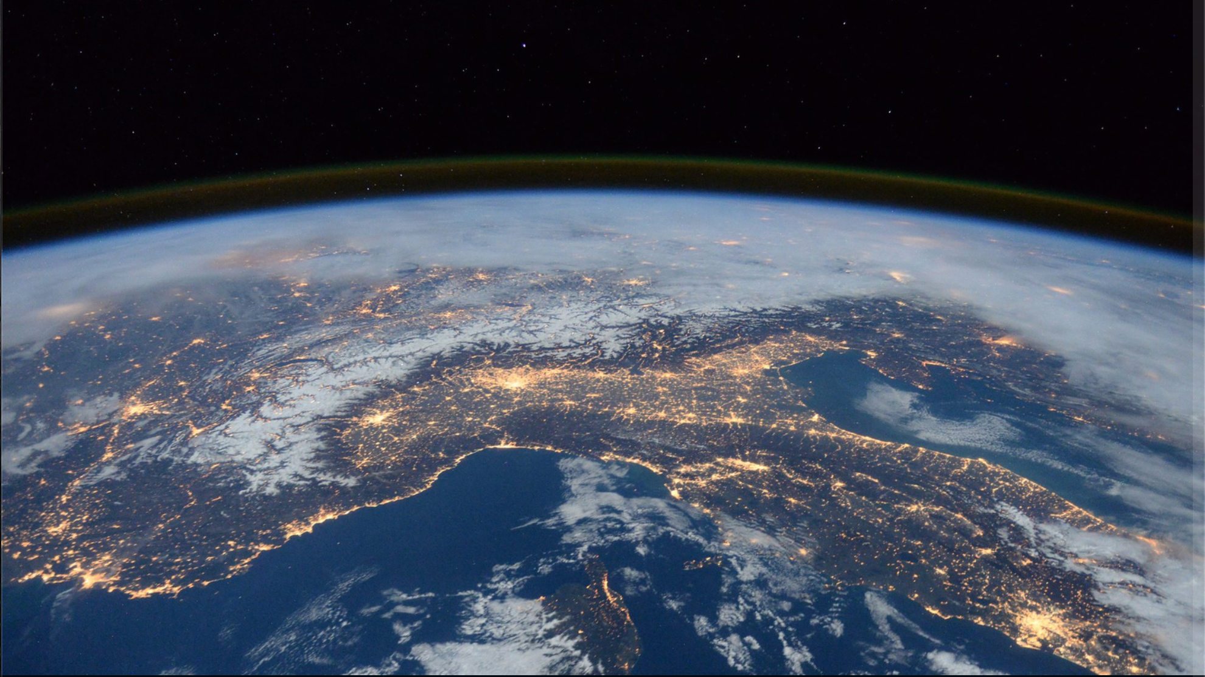
Conclusion
Virgin Galactic is a company the world’s first purpose commercial spaceship. The company that sends people to space for exploration in particular the planet earth. I believe that Virgin Galactic will help change the views of science and help the planet be safer. Our project could have been improved further by making our counter count down after reaching five to show the carrier returning back to earth.

